Slide 1
THE WORLD OF DATABASE SYSTEMS

Slide 2
Objectives
Understand concepts of:
Information
Data
Database
DBMS
DBS

Slide 3
Content
The evolution of database systems
Overview of a database management system
Outline of database system studies

Slide 4
The Evolution of Database systems
DB
A collection of information that exists over a long period of time
A collection of data that is managed by a DBMS
DBMS
A software package/system to facilitate the creation and maintenance of a computerized database
DBS
The DBMS software together with the data itself

Slide 5
The Evolution of Database systems
The DBMS is expected to
Allow users to create new databases and specify their schemas
Give users the ability to query the data
Support the storage of very large amounts of data
Enable durability
Control access to data from many users at once

Slide 6
The Evolution of Database systems
Early DBMSs
1960s, the first DBMS evolved from file system
These DBMS used several data models, such as
Tree-based model, graph-based network model
Hierarchical data model
Responsibility | Yes/No
(1) | Limited
(2) | Not directly supported
(3) | Yes
(4) | Not always supported
(5) | No

Slide 7
The Evolution of Database systems
Relational Database Systems
1970s, Edgar Codd defined relational model based on relations
SQL, the most important query language, was developed by IBM
1979, Oracle v.2, the first commercial RDBMS product using SQL

Slide 8
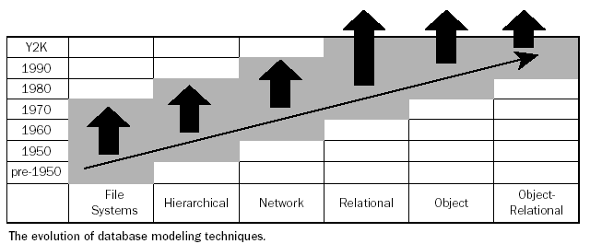
The Evolution of Database systems

Slide 9
The Evolution of Database systems
Smaller and Smaller Systems
Originally, DBMS’s were large, expensive software running on large computers
Today, DBMS can run on PC, Mobile, …
⇒DB systems based on the relational model are available for even very small machines
Bigger and Bigger Systems
Size of data has been increasingly continuously
Many databases store petabytes and serve it all to users

Slide 10
The Evolution of Database systems
Information Integration
Join the information contained in many related databases into a whole
Example: a large company has many divisions, each division have built its own database of products and employees on different DBMS’s and different structures
How we join these databases without any matters
Need to build structures on top of existing databases, with the goal of integrating the information distributed among them

Slide 11
The Evolution of Database systems
Information Integration (cont.)
Two popular approaches
Creation of data warehouses, where information from many databases is copied periodically, with the appropriate translation, to a central database
Implementation of a middleware (data mining) that support an integrated model of the data of the various databases, while translating between this model and the actual models used by each database

Slide 12
Overview of DBMS
Database Users
Database Administrators, authorize access to database, coordinate, monitor its use, acquiring software, and hardware resources, …
Database Designers, define the content, the structure, the constraints, and functions or transactions against the database
Database End users, use data for queries, reports and some of them actually update the database content

Slide 13
Overview of DBMS
Data Definition Language Commands
DBA needs special authority to execute schema-altering commands
Schema-altering commands are known as DDL commands, and used for defining data structure
These commands are parsed by a DDL processor and passed to the execution engine, then goes through the index/file/record manager to alter the metadata (schema information for the database)
Examples: CREATE, ALTER, DROP

Slide 14
Overview of DBMS
Data Manipulation Language Commands
Are used by computer programs or DB users to retrieve, insert, delete, and update data
Not affect the schema of the database, but affect the content of the database or extract data from database
DML has two separate subsystems
Answering the query
Transaction processing

Slide 15
Outline of Database System Studies
Part 1: Relational Database Modeling
Part 2: Relational Database Programming
Part 3: Semistructured Data Modeling and Programming
Part 4: Database System Implementation
Part 5: Modern Database Issues

